Slide 1
Master’s Thesis Defense
Design Space Exploration for SODA (Software-Defined Accelerator)
By: Darshith Manjunath
Committee: Dr. Chaitali Chakrabarti
Dr. Jeff Zhang
Dr. Vidya A. Chhabria

Slide 2
Problem Definition
Design Space Exploration for SODA framework that utilizes MLIR and High-Level Synthesis (HLS) methodologies.
Growing computational demands in Deep Learning.
To optimize hardware design for best PPA using compiler optimizations.
Need for rapid hardware prototyping.

Slide 3
Prior Work
Framework | Focus | Key Features | Limitations
POLSCA | Polybench kernels with loop transformations in HLS. | Enhances C++ code with loop transformations. | Limited to Polybench kernels, lacks neural network performance analysis.
ScaleHLS | Multi-level optimizations (graph, loop, directive) with focus on FPGAs. | Fine control over optimizations, impractical for ASICs. | Needs to be annotated back to HLS C, lacks layer-by-layer neural network analysis.
POM | FPGA-based accelerators using MLIR optimizations. | Advanced MLIR dependency analysis, layer-by-layer deep learning analysis. | Resource utilization increases with model size, problematic for ASICs.
SODA | Automated end-to-end hardware generation for both FPGA and ASIC. | Supports FPGA and ASIC, minimal manual intervention. | Loop optimization issues and ability to synthesize large neural networks.

Slide 4
Introduction

Slide 5
Python to GDS Pipeline
Python
LLVM file
tf-mlir-translate +
tf-opt / torch-mlir
Bambu
mlir-opt (protobuf to tosa and tosa to linalg)
Verilog
soda-opt
OpenRoad
mlir-opt (.mlir in llvm dialect to .ll llvm file)
GDS II Files

Slide 6
SODA-OPT Flow
-soda-outline-bambu-code
-soda-extract-arguments-to-xml
-soda-generate-bambu-accelcode
-soda-linalg-tile (optional)
-soda-opt-pipeline-for-bambu

Slide 7
MLIR Dialects in SODA-OPT
Linalg dialect
Affine dialect
Structured Control Flow (SCF) dialect
Control Flow (CF) dialect
LLVM dialect

Slide 8
SODA-OPT Pipeline for Bambu
Affine Loop Tiling
Gold color highlight indicates loop optimization
Optimizations performed by SODA at affine dialect
Affine Loop Permutation
Maroon color highlight indicates non-loop optimization
Linalg to Affine Loop Pass
Affine Data Copy Generate
Lower Affine
Expanded Strided Metadata
Promote Buffers to Stack
Convert SCF to CF
Affine Loop Unroll
Affine Scalar Replacement

Slide 9
Optimizations
Optimization category | Optimization | Remarks
Loop | Loop permutation | Swapping the order of nested loops.
 | Loop tiling | Breaking down a large loop into smaller blocks or tiles.
 | Loop unrolling | Expanding the loop body by replicating the operations.
Memory | Affine data copy generate | Creating local memory buffers, usually to optimize for locality.
 | Promote buffers to stack | Moves heap-allocated memory into stack-allocated memory.
 | Affine scalar replacement | Reducing memory traffic by promoting scalar values to registers.

Slide 10
Research Goals
1. Perform Design Space Exploration (DSE) for SODA framework with loop optimizations.
2. Results analysis and heuristic development for SODA framework.
Addressing loop optimization challenges for SODA.
Fold layers to synthesize large neural networks architectures.
Derive strategies to find best optimizations for neural network architectures.
Implement these heuristics on test architectures.
Evaluate the Power, Performance, and Area (PPA) of the test architectures.
Refine SODA pipeline for Bambu.

Slide 11
Design Space Exploration

Slide 12
DSE Framework flow for SODA
Input file
1. Argument parsing
2. Read MLIR file
3. Create temporary MLIR files
4. Design Space Exploration (DSE)
Output file
}
File pre-processing

Slide 13
Exploration
Types of neural network layers
Convolution layer
Depth-wise Convolution layer
Fully Connected layer
Optimizations
Loop permutation
Loop tiling
Loop unrolling
Architectures
Training architectures
Testing architectures
HLS configurations

Slide 14
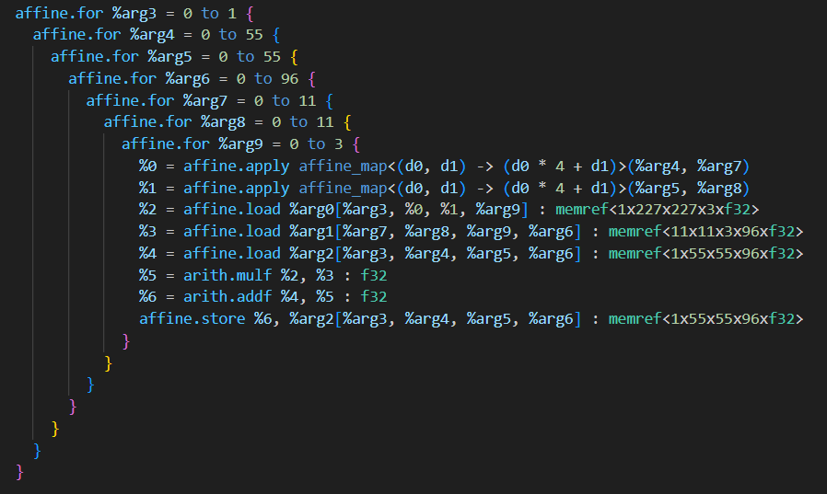
Neural Network Layer Type - 1
2D Convolution Layer
2D convolution layer in linalg dialect is represented by ‘linalg.conv_2d_nhwc_hwcf’.
Input feature map ‘nhwc’:
n: Batch number
h: Input height
w: Input width
c: Number of input channels
Kernel ‘hwcf’:
h: Kernel height
w: Kernel width
c: Number of input channels
f: Number of output channels
Output feature map ‘nhwf’:
n: Batch number
h: Output height
w: Output width
f: Number of output channels

Slide 15
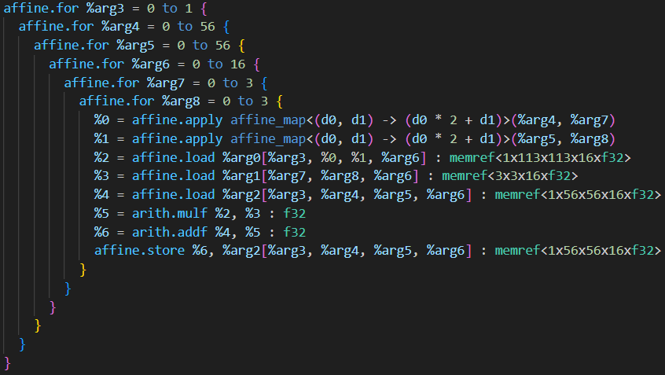
Neural Network Layer Type - 2
2D Depth-wise Convolution Layer
Depth-wise 2D convolution layer in linalg dialect is represented by ‘linalg.depthwise_conv_2d_nhwc_hwc’.
Input feature map ‘nhwc’:
n: Batch number
h: Input height
w: Input width
c: Number of input channels
Kernel ‘hwcm’:
h: Kernel height
w: Kernel width
c: Number of input channels
Output feature map ‘nhwcm’:
n: Batch number
h: Output height
w: Output width
c: Number of input channels

Slide 16
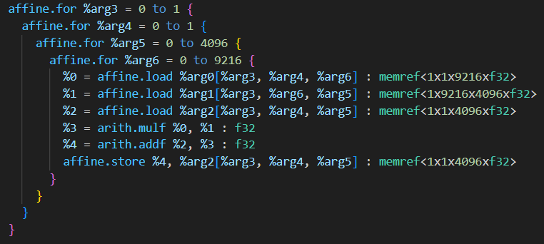
Neural Network Layer Type - 3
Fully Connected Layer
Fully Connecter layer in linalg dialect is represented by ‘linalg.batch_matmul’.
Input feature map ‘nhw’:
n: Batch number
h: Input height
w: Input width
Weight matrix:
n: Batch number
h: Weight matrix height
w: Weight matrix width
Output feature map ‘nhw’:
n: Batch number
h: Output height
w: Output width

Slide 17
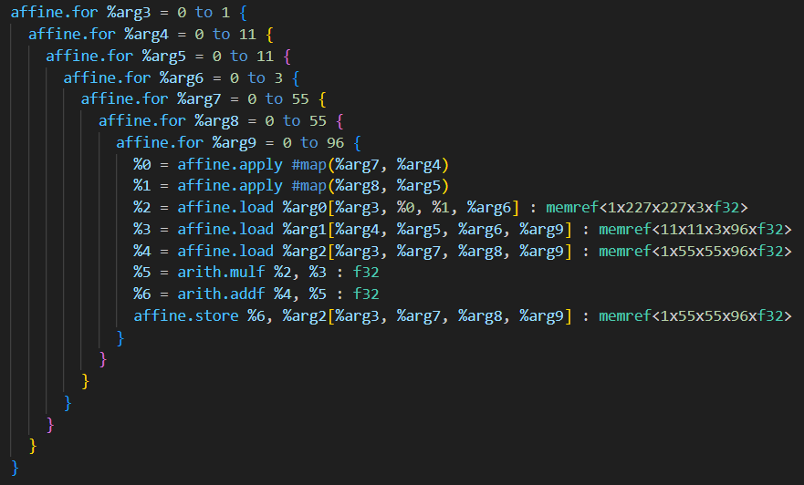
Optimization
Loop permutation
Convolution layer has 72 permutations to explore. 36 each for Output-first and Kernel-first permutations.
Depth-wise Convolution 24 permutations to explore. 12 each for Output-first and Kernel-first permutations.
FC layer has 6 different permutations to explore.
Output-first permutation for Convolution layer
Kernel-first permutation for Convolution layer

Slide 18
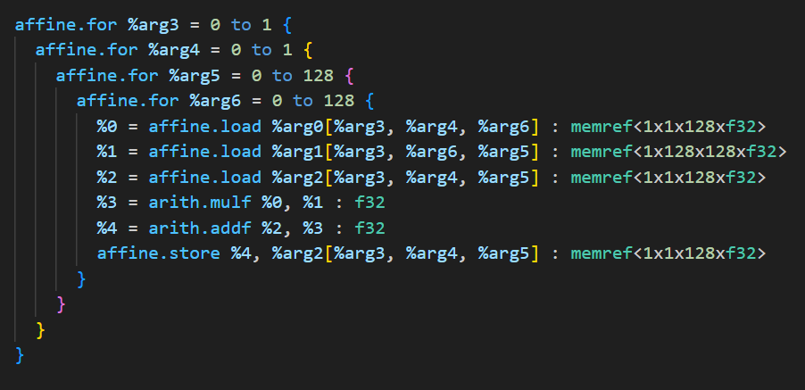
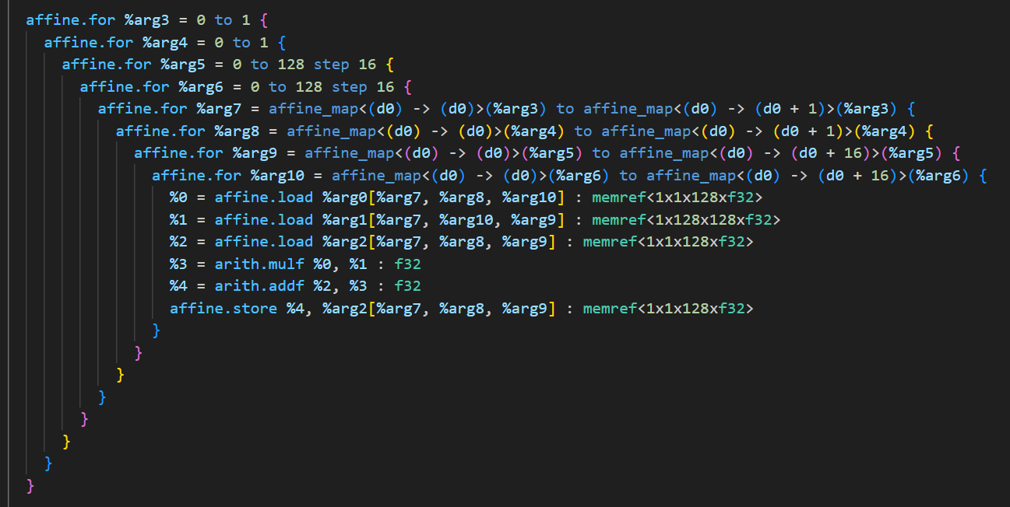
Optimization
Loop tiling
For FC layer, output height, output width, and kernel width are tiled in powers of 2 from 4 to the maximum dimension.
For Conv. and D-Conv. layers output height/width, kernel height/width and input channels are tiled.
FC layer before tiling
FC layer tiled to size 16

Slide 19
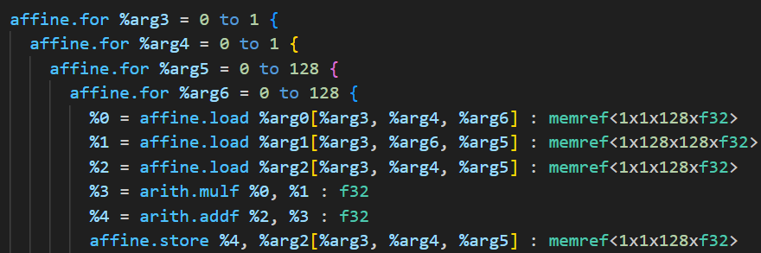
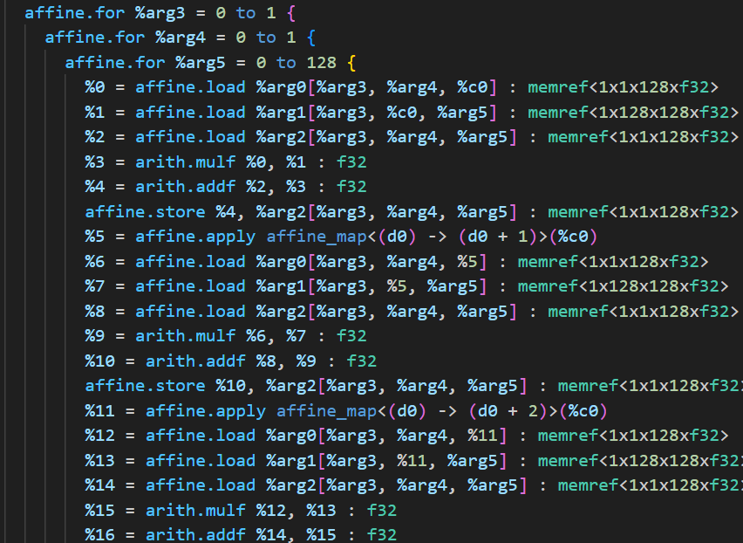
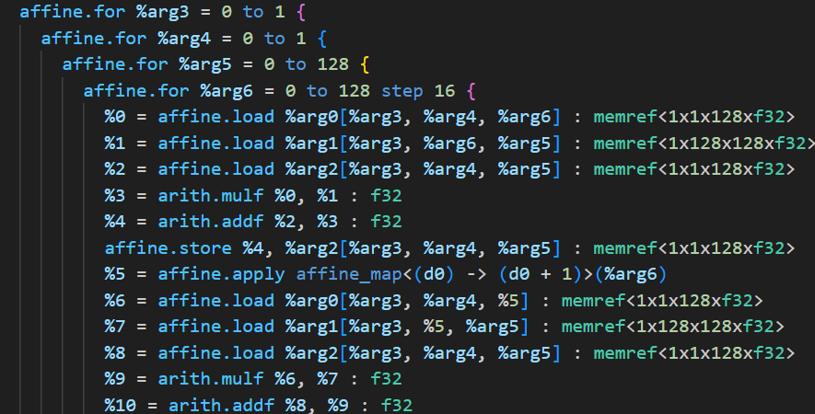
Optimization
Loop unrolling
For FC layer with no. of unrolls 1 and 2 with factors 4, 8, 16, and full-unroll are performed.
For Conv. and D-Conv. layers with no. of unrolls 1, 2, and 3 with factors 4, 8, 16, until full-unroll are performed.
FC layer before unrolling
Unroll 1 with factor 16
Unroll 1 with Full-unroll

Slide 20
Architectures Explored
Observed heuristics from:
No. | Model | No. of Conv. Layers | No. of D-Conv. Layers | No. of FC Layers | Total No. of Layers Explored
1 | LeNet | 3 | NA | 2 | 5
2 | AlexNet | 5 | NA | 3 | 8
3 | VGG-16 | 13 | NA | 3 | 16
4 | MobileNetV3-Small | - | 11 | NA | 11
Total |  | 21 | 11 | 8 | 40
Tested heuristics on:
No. | Model | No. of Conv. Layers | No. of D-Conv. Layers | No. of FC Layers | Total No. of Layers Explored
1 | VGG-19 | 16 | NA | 3 | 19
2 | ResNet-18 | 20 | NA | 1 | 21
3 | MobileNetV3-Large | - | 15 | NA | 15
Total |  | 36 | 15 | 4 | 55

Slide 21
HLS Configurations
Configuration | Values | Remarks
Maximum clock cycles | (2^32)-1 | Accommodates maximum allowable no. of clock cycles by Bambu’s testbench.
Frequency | 100MHz | No timing violations are observed at this frequency.
Memory allocation policy | NO_BRAM | Memory modules should not be synthesized. Memory modules are usually places as macros in ASICs.
PDK | NanGate45 | NanGate45 is a commonly used open-source PDK for 45nm technology.

Slide 22
Refinements for Exploration
Refinements for SODA pipeline
Affine Scalar Replacement
Affine data copy generate
Loop optimization order
Loop optimization issues
Loop permutation – 1 issue
Loop tiling – 2 issues
Loop unrolling – 2 issues
Folding neural network layers
Depth-wise Convolution mapping

Slide 23
Refined SODA-OPT Pipeline for Bambu
Affine Loop Permutation
Gold color highlight indicates loop optimization
New order of optimizations performed by SODA at affine dialect
Affine Loop Tiling
Maroon color highlight indicates non-loop optimization
Linalg to Affine Loop Pass
Affine Scalar Replacement
Lower Affine
Expanded Strided Metadata
Affine Loop Unroll
Convert SCF to CF
Affine Data Copy Generate
Promote Buffers to Stack

Slide 24
Refined SODA-OPT Pipeline for Bambu
Affine Scalar replacement
Affine Loop Permutation
Problem: Repeated access of scalar values with loops.
Effect: The number of scalar variables increases after unrolling, resulting in inefficiencies in the loop's performance. It is possible that SODA struggles at this stage while attempting to replace all the scalars
Impact: Reduces redundant memory accesses, simplifies unrolled loops, and improves overall loop performance.
Solution: Apply affine scalar replacement before loop unrolling to move scalar variables to registers.
Affine Loop Tiling
Affine Scalar Replacement
Affine Loop Unroll
Affine Data Copy Generate
Promote Buffers to Stack

Slide 25
Refined SODA-OPT Pipeline for Bambu
Affine data copy generate
Affine Loop Permutation
Problem: Unrolling buffer storage loop.
Effect: Buffer storage loops are created before unrolling, leading to unnecessary bottlenecks in the operation. Additionally, this process can significantly increase the time required to generate MLIR files.
Impact: Streamlined memory operations, reduced buffer overhead, and more efficient handling of expanded loop structures.
Solution: Apply affine data copy generation after loop unrolling to avoid unrolling buffers storing loop.
Affine Loop Tiling
Affine Scalar Replacement
Affine Loop Unroll
Affine Data Copy Generate
Promote Buffers to Stack

Slide 26
Refined SODA-OPT Pipeline for Bambu
Loop optimization order
Affine Loop Permutation
Problem: Performing loop permutation after loop tiling.
Challenge: Loop permutation following loop tiling creates an overly expansive exploration space, hindering optimization efficiency.
Solution: Reorder the optimizations to apply loop permutation before loop tiling, ensuring a more structured and manageable loop nest for permutation.
Impact: Every optimization builds on top of previous optimization’s improvements.
Affine Loop Tiling
Affine Scalar Replacement
Affine Loop Unroll
Affine Data Copy Generate
Promote Buffers to Stack

Slide 27
Loop Optimization Issues
Loop permutation
Problem 2: Permutation mapping doesn’t work correctly. The issue is in MLIR-OPT.
Problem 1: Cannot give permutation order to SODA.
Create custom set of passes to use perform loop permutation.
Created CSV files for all 3 linalgs to map correctly.
Permutation No. | Permutation tried | Does it work?
1 | 0,1,2,3 | Yes
2 | 0,1,3,2 | Yes
3 | 0,2,1,3 | Yes
4 | 0,2,3,1 | No (This maps to - 0,3,1,2)
5 | 0,3,1,2 | No (This maps to - 0,2,3,1)
6 | 0,3,2,1 | Yes
Layer Type | No. of permutations that map correctly | Total No. of permutations | % of correctly mapped permutations
linalg.conv2d_nhwc_hwcf | 22 | 72 | 30.56%
linalg.depthwise_conv_2d_nhwc_hwc | 10 | 24 | 41.67%
linalg.batch_matmul | 4 | 6 | 66.67%
Total | 36 | 102 | 35.30%

Slide 28
Loop Optimization Issues
Loop tiling
Issue 1: Uniform Tile Size Limitation in SODA Pipeline for Bambu
Problem: The SODA pipeline for Bambu only allows one uniform tile size, which limits flexibility in applying tiling optimizations.
Solution: Use the "Affine Tile Sizes" pass and create a custom set of passes to explore different tile sizes and optimize the process.
Issue 2: Promote Buffers to Stack Pass
Problem: The "Promote Buffers to Stack" pass causes the affine loop tiling pass to fail, throwing an error.
Solution: Remove the "Promote Buffers to Stack" pass entirely to allow the affine loop tiling pass to execute without errors, enabling successful tiling optimizations.

Slide 29
Loop Optimization Issues
Loop unrolling
Issue 1: Affine Scalar Replacement
Problem: Performing Affine Scalar Replacement too early can cause significant delays in replacing all scalars in the unrolled affine loop.
Solution: Perform loop unrolling after scalar replacement to efficiently handle scalars in unrolled loops.
Issue 2: Buffer Trick
Problem: Using temporary buffers to store intermediate values combined with loop unrolling creates an excess of buffers, complicating the synthesis process (e.g., using tools like Bambu for Verilog generation).
Solution: Remove the buffer trick for unrolling to simplify the number of buffers and streamline the synthesis process.

Slide 30
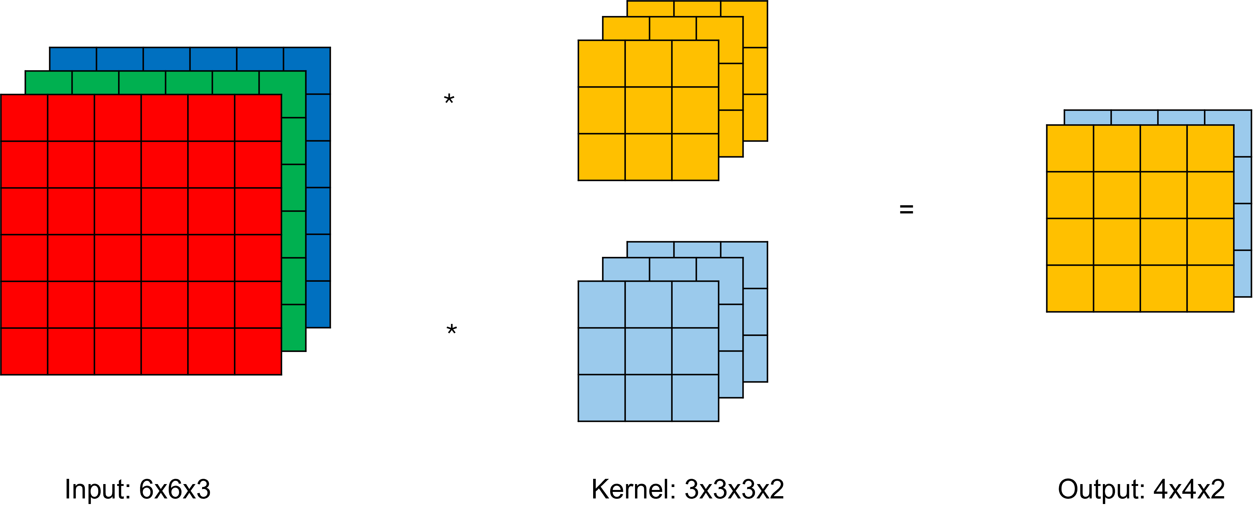
Folding layers
I/p feature map height/width | Max I/p channels
<=16 | 128
>16 and <=32 | 32
> 32 and <=64 | 8
> 64 | 1
Test bench has a time limit on how many cycles the design under test can be run for.
Input channels are folded according to input feature map dimension.
All the output channels are folded to 1.
Convolution and Depth-wise Convolution layers:
Fully Connected Layers: All the dimensions are folded to 128 for permutation and tiling) and folded to 32 for unrolling.
Further folding is done for unrolling.
Estimate total clock cycles for a layer by multiplying the clock cycles per tile by the number of tiles in the layer.
CNN layers folding for loop unrolling
I/p height/width | Kernel height/width | Max I/p channels
<=64 | <=3 | 32
 | >3 and <=5 | 8
 | > 5 and <=7 | 4
 | > 7 | 1
>64 | 1 - 11 | 1

Slide 31
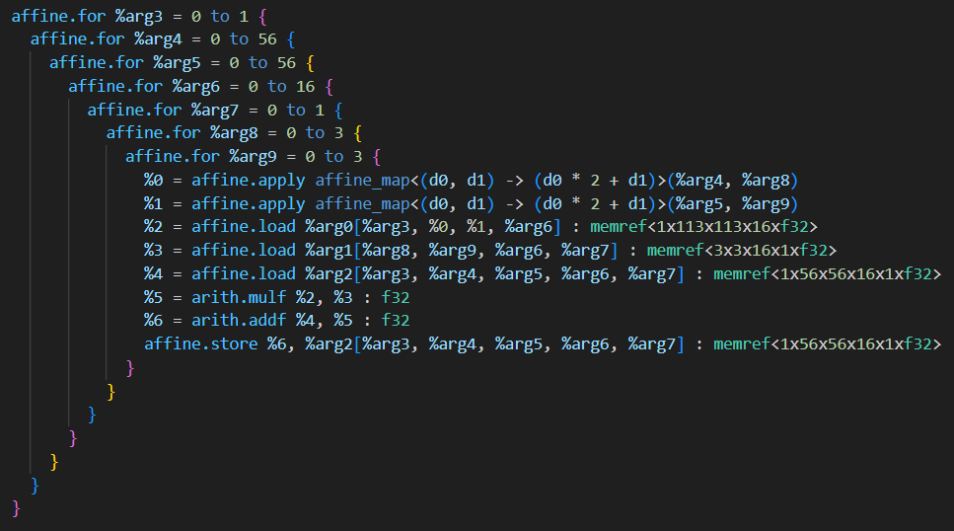
Depth-wise Convolution Mapping
linalg.depth_conv2d_nhwc_hwcm at affine level:
linalg.depth_conv2d_nhwc_hwc at affine level:
The depth-wise convolution with multiplier doesn’t perform well with certain loop optimizations, so we map it to the depth-wise convolution with no multiplier.
It helps with mapping any type of depth-wise convolution to the same kind of layer to explore.
Configuration | Clock cycles
Baseline | 673,486
Unroll - 3 | 673,486
Configuration | Clock cycles
Baseline | 673,486
Unroll - 3 | 198,092

Slide 32
Results

Slide 33
Results Evaluated
Parameters | Remarks | Formula
Clock cycles | Number of clock cycles required to complete a layer of the neural network. | N
Runtime | Duration needed to process a single layer of the neural network, measured in seconds. | T = N / frequency
Total Power | Power consumption of the ASIC during operation, measured in watts. | P
Area | Physical area occupied by the ASIC layout, measured in square micro meters (µm²). | -
GFLOPS | Indicates the computational performance of the ASIC, measured in Giga FLOPS. | GFLOPS = FLOP count / T
GFLOPS/W | Represents the energy efficiency of the ASIC, calculated as performance per watt. | GFLOPS/W = GFLOPS / P
Energy | Energy consumed by the ASIC in Joules. | E = P * T
Main goal is to evaluate Power, Performance and Area (PPA) along with efficiency.

Slide 34
Permutation - CNN Layer
Case: Kernels with no. of input channels > 1 - Results
Layer info | Input |  |  | Kernel |  |  |  | Output
 | H | W | C | H | W | C | F | H | W | F
Actual | 15 | 15 | 256 | 3 | 3 | 256 | 384 | 13 | 13 | 256
Executed | 15 | 15 | 32 | 3 | 3 | 32 | 1 | 13 | 13 | 1
AlexNet CNN Layer 3:
Baseline permutation:
Permutation | Clock cycles | Total power | Area | Runtime | GFLOPS | GFLOPS/W | Energy
0,1,2,3,4,5,6 | 841,064,448 | 0.0123 | 109,121 | 8.410644 | 0.035555 | 2.89065 | 0.103451
Output-first permutation always yields the best performance.
Best Output-first permutation:
Permutation | Clock cycles | Total power | Area | Runtime | GFLOPS | GFLOPS/W | Energy
0,1,2,3,5,6,4 | 691,414,272 | 0.0115 | 103,378 | 6.914143 | 0.043251 | 3.760957 | 0.079513
Best Kernel-first permutation:
Permutation | Clock cycles | Total power | Area | Runtime | GFLOPS | GFLOPS/W | Energy
0,4,5,6,1,2,3 | 981,087,744 | 0.0135 | 118,153 | 9.810877 | 0.030481 | 2.257852 | 0.132447

Slide 35
Permutation – CNN Layer
Case: Kernels with no. of input channels > 1 - Methodology
Sweep (kernel permutation): Sweep the kernel dimensions and get the best permutation.
Permutation | Clock cycles | Total power | Area | Runtime | GFLOPS | GFLOPS/W | Energy
0,1,2,3,4,5,6 | 841,064,448 | 0.0123 | 109121 | 8.410644 | 0.035555 | 2.89065 | 0.103451
0,1,2,3,4,6,5 | 691,414,272 | 0.0114 | 103105 | 6.914143 | 0.043251 | 3.793947 | 0.078821
0,1,2,3,5,4,6 | 841,064,448 | 0.0122 | 108384 | 8.410644 | 0.035555 | 2.914344 | 0.10261
0,1,2,3,5,6,4 | 691,414,272 | 0.0115 | 103378 | 6.914143 | 0.043251 | 3.760957 | 0.079513
0,1,2,3,6,4,5 | 691,414,272 | 0.0107 | 98348 | 6.914143 | 0.043251 | 4.04215 | 0.073981
0,1,2,3,6,5,4 | 691,414,272 | 0.0117 | 99618 | 6.914143 | 0.043251 | 3.696667 | 0.080895
Only kernel dimensions input provides performance improvement.

Slide 36
Permutation – D-CNN
Case: Kernels with no. of input channels > 1 - Results
Layer info | Input |  |  | Kernel |  |  | Output
 | H | W | C | H | W | C | H | W | C
Actual | 57 | 57 | 72 | 3 | 3 | 72 | 28 | 28 | 72
Executed | 57 | 57 | 8 | 3 | 3 | 8 | 28 | 28 | 8
Mobilenet-v3-small D-CNN Layer 2:
Baseline permutation:
Permutation | Clock cycles | Total power | Area | Runtime | GFLOPS | GFLOPS/W | Energy
0,1,2,3,4,5 | 2,948,913 | 0.0118 | 96,654 | 0.029489 | 0.034456 | 2.92 | 0.000348
Output-first permutation always yields the best performance.
Best permutations (Output first permutation):
Permutation | Clock cycles | Total power | Area | Runtime | GFLOPS | GFLOPS/W | Energy
0,3,2,1,5,4 | 2,379,933 | 0.0123 | 101,655 | 0.023799 | 0.042694 | 3.471057 | 0.000293
Best permutations (Kernel first permutation):
Permutation | Clock cycles | Total power | Area | Runtime | GFLOPS | GFLOPS/W | Energy
0,5,3,4,2,1 | 3,808,440 | 0.0112 | 94,712 | 0.038084 | 0.02668 | 2.382143 | 0.000427

Slide 37
Permutation – FC Layer
Case 1: Small layers - Results
Layer info | Input |  | Weights |  | Output
 | H | W | H | W | H | W
Actual | 1 | 84 | 84 | 10 | 1 | 10
Executed | 1 | 84 | 84 | 10 | 1 | 10
LeNet Fully Connected (FC) Layer 2:
Dataset with small number of classes like MNIST need to use this loop permutation to get best performance.
Permutation | Clock cycles | Total power | Area | Runtime | GFLOPS | GFLOPS/W | Energy
0,1,2,3 | 7,652 | 0.00601 | 52,803.0 | 7.7e-05 | 0.021818 | 3.630283 | 4.6277e-07
0,1,3,2 | 4,706 | 0.00659 | 61,364.0 | 4.7e-05 | 0.035745 | 5.424127 | 3.0973e-07
0,2,1,3 | 7,652 | 0.00595 | 52,454.0 | 7.7e-05 | 0.021818 | 3.666891 | 4.5815e-07
0,2,3,1 | 7,652 | 0.00595 | 52,441.0 | 7.7e-05 | 0.021818 | 3.666891 | 4.5815e-07
0,3,1,2 | 4,706 | 0.00661 | 61,975.0 | 4.7e-05 | 0.035745 | 5.407716 | 3.1067e-07
0,3,2,1 | 4,706 | 0.00659 | 61,931.0 | 4.7e-05 | 0.035745 | 5.424127 | 3.0973e-07
For smaller FC layers, loop permutations (0,1,3,2) or (0,3,1,2) or (0,3,2,1) could be picked to get best performance, power efficiency at the cost of area.

Slide 38
Permutation – FC Layer
Case 2: Large layers - Results
Layer info | Input |  | Weights |  | Output
 | H | W | H | W | H | W
Actual | 1 | 9216 | 9216 | 4096 | 1 | 4096
Executed | 1 | 128 | 128 | 128 | 1 | 128
AlexNet Fully Connected (FC) Layer 1:
Dataset with large number of classes like ImageNet need to use this loop permutation to get best performance.
Permutation | Clock cycles | Total power | Area | Runtime | GFLOPS | GFLOPS/W | Energy
0,1,2,3 | 317,721,600.0 | 0.00415 | 32,699.0 | 3.177216 | 0.023762 | 5.725783 | 0.0131854464
0,1,3,2 | 355,175,424.0 | 0.00398 | 32,030.0 | 3.551754 | 0.021256 | 5.340704 | 0.01413598092
0,2,1,3 | 317,721,600.0 | 0.00408 | 32,329.0 | 3.177216 | 0.023762 | 5.82402 | 0.01296304128
0,2,3,1 | 317,721,600.0 | 0.00415 | 32,699.0 | 3.177216 | 0.023762 | 5.725783 | 0.0131854464
0,3,1,2 | 355,175,424.0 | 0.00398 | 32,030.0 | 3.551754 | 0.021256 | 5.340704 | 0.01413598092
0,3,2,1 | 355,175,424.0 | 0.00398 | 32,030.0 | 3.551754 | 0.021256 | 5.340704 | 0.01413598092
For smaller FC layers, loop permutations (0,1,3,2) or (0,3,1,2) or (0,3,2,1) could be picked to get best performance, power efficiency at the cost of area.

Slide 39
Tiling - CNN
Case 1: Kernels with no. of input channels > 1 - Results.
Layer info | Input |  |  | Kernel |  |  |  | Output
 | H | W | C | H | W | C | F | H | W | F
Actual | 15 | 15 | 384 | 3 | 3 | 384 | 256 | 13 | 13 | 256
Executed | 15 | 15 | 128 | 3 | 3 | 128 | 1 | 13 | 13 | 1
AlexNet CNN Layer 5:
Best tiling configuration depends on the layer’s input dimensions.
Baseline configuration:
Tile | Clock cycles | Total power | Area | Runtime | GFLOPS | GFLOPS/W | Energy
None | 841,099,008 | 0.0137 | 111,099 | 8.41099 | 0.035554 | 2.595182 | 0.115231
Best configuration:
Tile | Clock cycles | Total power | Area | Runtime | GFLOPS | GFLOPS/W | Energy
1,13,13,1,3,3,16 | 695,159,040 | 0.0196 | 170,582 | 6.95159 | 0.043018 | 2.194796 | 0.136251

Slide 40
Tiling - CNN
Case 1: Kernels with no. of input channels > 1 - Methodology
Input channel tiled to 16 yield best performance.

Slide 41
Tiling - CNN
Case 2: Kernel tiling
Layer info | Input |  |  | Kernel |  |  |  | Output
 | H | W | C | H | W | C | F | H | W | F
Actual | 31 | 31 | 96 | 5 | 5 | 96 | 256 | 27 | 27 | 256
Executed | 31 | 31 | 32 | 5 | 5 | 32 | 1 | 27 | 27 | 1
AlexNet CNN Layer 2:
Kernel tiled to size 3:
Tile | Clock cycles | Total power | Area | Runtime | GFLOPS | GFLOPS/W | Energy
1,8,8,1,3,3,4 | 2,059,048,704 | 0.0156 | 142,327 | 20.59049 | 0.043505 | 2.788782 | 0.321212
1,8,8,1,3,3,8 | 1,975,428,864 | 0.015 | 132,551 | 19.75429 | 0.045347 | 3.023133 | 0.296314
1,8,8,1,3,3,16 | 1,933,594,368 | 0.0162 | 144,709 | 19.33594 | 0.046328 | 2.859753 | 0.313242
1,8,8,1,3,3,32 | 2,360,451,840 | 0.0153 | 134,921 | 23.60452 | 0.03795 | 2.480392 | 0.361149
Kernel tiling gives bad performance. Always exclude kernel tiling in exploration.
No kernel tiling:
Tile | Clock cycles | Total power | Area | Runtime | GFLOPS | GFLOPS/W | Energy
1,8,8,1,5,5,4 | 1,911,125,760 | 0.0169 | 154,230 | 19.11126 | 0.046873 | 2.77355 | 0.32298
1,8,8,1,5,5,8 | 1,912,603,392 | 0.0145 | 129,005 | 19.12603 | 0.046836 | 3.230069 | 0.277327
1,8,8,1,5,5,16 | 1,902,144,768 | 0.0156 | 137,951 | 19.02145 | 0.047094 | 3.018846 | 0.296735
1,8,8,1,5,5,32 | 2,347,600,128 | 0.0144 | 127,741 | 23.476 | 0.038158 | 2.649861 | 0.338054

Slide 42
Tiling – FC layer
Results
Layer info | Input |  | Weights |  | Output
 | H | W | H | W | H | W
Actual | 1 | 4096 | 4096 | 1000 | 1 | 1000
Executed | 1 | 128 | 128 | 125 | 1 | 125
AlexNet Fully Connected (FC) Layer 3:
Best tiling configuration depends on whether the layer is a hidden layer or output layer.
Baseline configuration:
Tile | Clock cycles | Total power | Area | Runtime | GFLOPS | GFLOPS/W | Energy
None | 34,511,104 | 0.00454 | 36,055 | 0.345111 | 0.023737 | 5.228414 | 0.001567
Best configuration:
Tile | Clock cycles | Total power | Area | Runtime | GFLOPS | GFLOPS/W | Energy
1,1,64,16 | 31,124,736 | 0.0142 | 118,464.0 | 0.311247 | 0.02632 | 1.853521 | 0.0044197074

Slide 43
Tiling – FC layer
Methodology
First sweep (Tiling innermost loop): The configuration 1,1,4,16 provides the best performance. Fix innermost loop tile to 16.
Tile | Clock cycles | Total power | Area | Runtime | GFLOPS | GFLOPS/W | Energy
1,1,4,4 | 35,244,032 | 0.0059 | 51,098 | 0.35244 | 0.023244 | 3.939661 | 0.002079396
1,1,4,8 | 33,314,816 | 0.00748 | 62,642 | 0.333148 | 0.02459 | 3.287433 | 0.002491947
1,1,4,16 | 32,350,208 | 0.00978 | 83,972 | 0.323502 | 0.025323 | 2.589264 | 0.00316385
1,1,4,32 | 39,007,488 | 0.00634 | 55,984 | 0.390075 | 0.021001 | 3.312461 | 0.002473076
1,1,4,64 | 34,655,488 | 0.00484 | 43,138 | 0.346555 | 0.023638 | 4.883884 | 0.001677326
1,1,4,128 | 34,527,488 | 0.00471 | 37,766 | 0.345275 | 0.023726 | 5.037367 | 0.001626245
Second sweep (Tiling outer loop): The optimal tiling configuration for the fully connected layer is 1,1,64,16.
Tile | Clock cycles | Total power | Area | Runtime | GFLOPS | GFLOPS/W | Energy
1,1,4,16 | 32,350,208 | 0.00978 | 83,972 | 0.323502 | 0.025323 | 2.589264 | 0.00316384956
1,1,8,16 | 31,719,424 | 0.00979 | 84,101 | 0.317194 | 0.025826 | 2.637998 | 0.00310532926
1,1,16,16 | 31,404,032 | 0.00992 | 84,888 | 0.31404 | 0.026086 | 2.629637 | 0.0031152768
1,1,32,16 | 31,246,336 | 0.00983 | 84,589 | 0.312463 | 0.026218 | 2.667141 | 0.00307151129
1,1,64,16 | 31,124,736 | 0.0142 | 118,464 | 0.311247 | 0.02632 | 1.853521 | 0.0044197074
1,1,125,16 | 31,125,504 | 0.00956 | 80,886 | 0.311255 | 0.026319 | 2.753033 | 0.0029755978

Slide 44
Unrolling - CNN
Case 1: Unrolling larger kernel width/height with no. of input channels 1 - Results
Layer info | Input |  |  | Kernel |  |  |  | Output
 | H | W | C | H | W | C | F | H | W | F
Actual | 227 | 227 | 3 | 11 | 11 | 3 | 96 | 55 | 55 | 96
Executed | 227 | 227 | 1 | 11 | 11 | 1 | 1 | 55 | 55 | 1
AlexNet CNN Layer 1:
With larger kernel size and no. of input channels being 1, the effects of unrolling is seen after unrolling inner-most loops 3 times.
No. of unrolls | Unroll Factor | Clock cycles | Total power | Area | Runtime | GFLOPS | GFLOPS/W | Energy
0 | 0 | 425,162,016 | 0.00398 | 39,522 | 4.25162 | 0.049588 | 12.459296 | 0.0169214476
1 | Full-unroll | 425,162,016 | 0.004 | 39,614 | 4.25162 | 0.049588 | 12.397 | 0.01700648
2 | 4 | 425,162,016 | 0.004 | 39,607 | 4.25162 | 0.049588 | 12.397 | 0.01700648
2 | 8 | 425,162,016 | 0.004 | 39,542 | 4.25162 | 0.049588 | 12.397 | 0.01700648
2 | Full-unroll | 425,162,016 | 0.00395 | 39,395 | 4.25162 | 0.049588 | 12.553924 | 0.016793899
3 | 4 | 396,422,208 | 0.0168 | 152,200 | 3.964222 | 0.053183 | 3.165655 | 0.0665989296
3 | 8 | 318,195,072 | 0.0312 | 251,698 | 3.181951 | 0.066258 | 2.123654 | 0.0992768712
3 | Full-unroll | 318,350,592 | 0.0322 | 248,566 | 3.183506 | 0.066226 | 2.056708 | 0.1025088932

Slide 45
Unrolling - CNN
Case 2: Unrolling kernels with no. of input channels > 1 - Results
Layer info | Input |  |  | Kernel |  |  |  | Output
 | H | W | C | H | W | C | F | H | W | F
Actual | 15 | 15 | 384 | 3 | 3 | 384 | 256 | 13 | 13 | 256
Executed | 15 | 15 | 32 | 3 | 3 | 32 | 1 | 13 | 13 | 1
AlexNet CNN Layer 5:
As we unroll further loops fully, performance improves further at a significant penalty of power, area, and efficiency.
Unrolling 1 with unrolling factor 4, 8, 16 yields performance while also improving on power, area, and efficiency.
No. of unrolls | Unroll Factor | Clock cycles | Total power | Area | Runtime | GFLOPS | GFLOPS/W | Energy
0 | 0 | 750,243,840 | 0.00497 | 45,452 | 7.502438 | 0.039859 | 8.01992 | 0.03728711686
1 | 4 | 603,319,296 | 0.00436 | 39,082 | 6.033193 | 0.049566 | 11.368349 | 0.02630472148
1 | 8 | 606,434,304 | 0.00327 | 29,279 | 6.064343 | 0.049311 | 15.079817 | 0.01983040161
1 | 16 | 606,434,304 | 0.00491 | 39,412 | 6.064343 | 0.049311 | 10.042974 | 0.02977592413
1 | Full-unroll | 601,761,792 | 0.00755 | 65,218 | 6.017618 | 0.049694 | 6.581987 | 0.0454330159
2 | Full-unroll | 600,204,288 | 0.0232 | 177,517 | 6.002043 | 0.049823 | 2.147543 | 0.1392473976
3 | Full-unroll | 457,986,048 | 0.0649 | 509,320 | 4.57986 | 0.065295 | 1.006086 | 0.297232914

Slide 46
Unrolling – D-CNN
Case: Unrolling kernels with no. of input channels > 1 - Results
Layer info | Input |  |  | Kernel |  |  | Output
 | H | W | C | H | W | C | H | W | C
Actual | 57 | 57 | 72 | 3 | 3 | 72 | 28 | 28 | 72
Executed | 57 | 57 | 24 | 3 | 3 | 24 | 28 | 28 | 24
Mobilenet-v3-small
D-CNN Layer 2:
Unroll-3 improves performance. Unroll factor improves performance without smaller power and area penalties compared to full-unroll.
Unrolls | Unroll Factor | Clock cycles | Total power | Area | Runtime | GFLOPS | GFLOPS/W | Energy
0 | 0 | 2,203,914 | 0.00377 | 36,695 | 0.022039 | 0.046103 | 12.22891 | 8.31E-05
1 | Full-unroll | 2,203,914 | 0.00375 | 36,261 | 0.022039 | 0.046103 | 12.29413 | 8.26E-05
2 | Full-unroll | 2,203,914 | 0.00374 | 35,808 | 0.022039 | 0.046103 | 12.32701 | 8.24E-05
3 | 4 | 1,357,194 | 0.00941 | 88,117 | 0.013572 | 0.074865 | 7.955898 | 0.000128
3 | 8 | 1,230,186 | 0.0166 | 152,923 | 0.012302 | 0.082593 | 4.975482 | 0.000204
3 | 16 | 1,173,036 | 0.042 | 343,284 | 0.01173 | 0.086621 | 2.062405 | 0.000493
3 | Full-unroll | 645,180 | 0.0579 | 466,803 | 0.006452 | 0.15748 | 2.719862 | 0.000374

Slide 47
Unroll - FC Layer
Layer info | Input |  | Weights |  | Output
 | H | W | H | W | H | W
Actual | 1 | 9216 | 9216 | 4096 | 1 | 4096
Executed | 1 | 32 | 32 | 32 | 1 | 32
AlexNet Fully Connected (FC) Layer 1:
Unrolling 1 with any factor doesn’t make any difference to the performance.
Unrolling 2 with factors does improve performance at the cost of power, area and efficiency.
No. of Unrolls | Unroll Factor | Clock cycles | Total power | Area | Runtime | GFLOPS | GFLOPS/W | Energy
0 | 0 | 155,787,264 | 0.0014 | 12,258 | 1.557873 | 0.048462 | 34.615714 | 0.0021810222
1 | 4 | 118,038,528 | 0.0088 | 70,710 | 1.180385 | 0.06396 | 7.218962 | 0.0104582111
1 | 8 | 118,038,528 | 0.0088 | 70,417 | 1.180385 | 0.06396 | 7.202703 | 0.0104818188
1 | 16 | 118,038,528 | 0.0088 | 71,035 | 1.180385 | 0.06396 | 7.194601 | 0.01049362265
1 | full-unroll | 118,038,528 | 0.0088 | 70,921 | 1.180385 | 0.06396 | 7.251701 | 0.0104109957
2 | 4 | 59,645,952 | 0.0228 | 178,788 | 0.59646 | 0.126576 | 5.551579 | 0.013599288
2 | 8 | 50,208,768 | 0.0383 | 323,216 | 0.502088 | 0.150367 | 3.926031 | 0.0192299704
2 | 16 | 45,490,176 | 0.0711 | 575,059 | 0.454902 | 0.165964 | 2.334233 | 0.0323435322
2 | full-unroll | 43,057,152 | 0.166 | 1,146,979 | 0.430572 | 0.175342 | 1.056277 | 0.071474952

Slide 48
Heuristics
Convolution layer
I/p feature map height/width | Loop permutation | Loop tiling | Loop unrolling
size <=16 | 0,1,2,3,5,6,4 | 1,<actual o/p height>,<actual o/p width>,1, <actual kernel height>,<actual kernel width>,16 | Unroll 3 - Full unroll
16 < size <=32 | 0,1,2,3,5,6,4 | 1,8,8,1,<actual kernel height>,<actual kernel width>,16 | Unroll 3 - Full unroll
32 < size <=64 | 0,1,2,3,5,6,4 | Baseline | Unroll 3 - Full unroll
size > 64 | Baseline | Baseline | Baseline
For input feature map sizes greater than 64, where both input and output channels are equal to one, no loop optimization techniques are effective. In this scenario, the baseline configuration provides the best performance.

Slide 49
Heuristics
Depth-wise Convolution layer
I/p feature map height/width | Loop permutation | Loop unrolling
size <=16 | 0,3,2,1,5,4 | Unroll 3 - Full unroll
16 < size <=32 | 0,3,2,1,5,4 | Unroll 3 - Full unroll
32 < size <=64 | 0,3,2,1,5,4 | Unroll 3 - Full unroll
size > 64 | Baseline | Baseline
For input feature map sizes greater than 64, where both input and output channels are equal to one, no loop optimization techniques are effective. In this scenario, the baseline configuration provides the best performance.

Slide 50
Heuristics
Fully Connected layer
Type | Loop permutation | Loop tiling | Loop unrolling
Hidden layer | Baseline | 1,1,4,4 | Unroll 2 - Full unroll
Output layer | Baseline | 1,1,64,16 | Unroll 2 - Full unroll
Output layer is assumed to be for ImageNet dataset with 1000 classes.

Slide 51
Predicting on Test Architectures
Loop permutation
ResNet-18
Layer No. | Layer type | Best permutation configuration | Heuristic
1 | Conv2D | Baseline | ✓
2 - 7 | Conv2D | 0,1,2,3,5,6,4 | ✓
8 | Conv2D | Baseline | ✘
9 - 12 | Conv2D | 0,1,2,3,5,6,4 | ✓
13 | Conv2D | Baseline | ✘
14 - 17 | Conv2D | 0,1,2,3,5,6,4 | ✓
18 | Conv2D | Baseline | ✘
19-20 | Conv2D | 0,1,2,3,5,6,4 | ✓
21 | FC | Baseline | ✓
VGG-19
Layer No. | Layer type | Best permutation configuration | Heuristic
1 - 4 | Conv2D | Baseline | ✓
5 - 16 | Conv2D | 0,1,2,3,5,6,4 | ✓
17 - 19 | FC | Baseline | ✓
Certain configurations within the Convolutional layers are not achieving optimal permutation configurations using the current heuristics.
In contrast, the heuristics are effectively determining the best permutation configurations for the Depth-wise Convolutional layers and Fully Connected layers.
MobileNetV3-Large
Layer No. | Layer type | Best permutation configuration | Heuristic
1-2 | D-Conv2D | Baseline | ✓
3-15 | D-Conv2D | 0,3,2,1,5,4 | ✓

Slide 52
Conv. I/p size > 64
Conv. 32 < I/p size <= 64
Conv. I/p size <= 32
FC layer
Loop permutation for convolution improves performance. But the variation in power and area depends on the size of the i/p layer size.
FC layer doesn’t see any difference as baseline is the best configuration.

Slide 53
I/p size > 64
I/p size <= 64
Loop permutation helps improve performance with marginal penalties in power and area.

Slide 54
Predicting on Test Architectures
Loop tiling
ResNet-18
Layer No. | Layer Type | Best Tiling configuration | Heuristic
1-7 | Conv2D | Baseline | ✓
8 | Conv2D | 1,4,4,1,1,1,4 | ✘
9-10 | Conv2D | 1,8,8,1,3,3,16 | ✓
11 | Conv2D | 1,14,14,1,3,3,8 | ✘
12 | Conv2D | 1,14,14,1,3,3,16 | ✓
13 | Conv2D | 1,14,14,1,1,1,16 | ✓
14-15 | Conv2D | 1,14,14,1,3,3,16 | ✓
16-17 | Conv2D | 1,7,7,1,3,3,16 | ✓
18 | Conv2D | 1,7,7,1,1,1,16 | ✓
19-20 | Conv2D | 1,7,7,1,3,3,16 | ✓
21 | FC | 1,1,64,16 | ✓
VGG-19
Layer No. | Layer Type | Best Tiling configuration | Heuristic
1-8 | Conv2D | Baseline | ✓
9-12 | Conv2D | 1,8,8,1,3,3,16 | ✓
13-16 | Conv2D | 1,14,14,1,3,3,16 | ✓
17-18 | FC | 1,1,4,4 | ✓
19 | FC | 1,1,64,16 | ✓
Heuristics work for FC layer. But, for Convolution layers the heuristic fails to find the best tiling configuration on 2 occasions.

Slide 55
Conv. I/p size > 32
Conv. 16 < I/p size <= 32
Conv. I/p size <= 16
FC hidden layer
FC o/p layer
Improvement in PPA depends on size of Conv. layer size.
FC hidden layer improves performance with penalties in power and area.
Output layer marginally improves performance, with significant penalties in power and area.

Slide 56
Predicting on Test Architectures
Loop unrolling
ResNet-18
Layer No. | Layer Type | Unrolling configuration | Heuristics
1 | Conv2D | Baseline | ✓
2-20 | Conv2D | Unroll 3 - Full-unroll | ✓
21 | FC | Unroll 2 - Full-unroll | ✓
MobileNetV3-Large
Layer No. | Layer Type | Unrolling configuration | Heuristics
1-2 | D-Conv2D | Baseline | ✓
3-15 | D-Conv2D | Unroll 3 - Full-unroll | ✓
Unrolling – VGG19
Layer No. | Layer Type | Unrolling configuration | Heuristics
1-4 | Conv2D | Baseline | ✓
5-16 | Conv2D | Unroll 3 - Full-unroll | ✓
17-19 | FC | Unroll 2 - Full-unroll | ✓
Loop unrolling heuristics works correctly for all the layers tried.

Slide 57
Conv. I/p size > 64
Conv. I/p size > 64
FC layer
Loop permutations provide substantial performance improvements; however, they also incur a significant penalty in power consumption and area, particularly for fully connected (FC) layers.

Slide 58
I/p size > 64
I/p size <= 64
Loop permutations provide substantial performance improvements; however, they also incur a significant penalty in power consumption and area.

Slide 59
Summary
Symbol | Remarks
⬆ | Increase in value
⬇ | Decrease in value
- | No change in value
✘ | Doesn’t work
* | Varies based on the specific case, such as layer size (large or small).
Highlight label
Indicates good change
Indicates bad change
Layer Type | Optimization | Power | Performance | Area | Efficiency | Energy
Convolution Layer | Loop Permutation | * | ⬆ | * | * | *
 | Loop Tiling | ⬆ | ⬆ | ⬆ | ⬇ | ⬆
 | Loop Unrolling | ⬆ | ⬆ | ⬆ | ⬇ | ⬆
Depth-wise Convolution Layer | Loop Permutation | ⬆ | ⬆ | ⬆ | ⬆ | ⬇
 | Loop Tiling | ✘
 | Loop Unrolling | ⬆ | ⬆ | ⬆ | ⬇ | ⬆
Fully Connected Layer | Loop Permutation | -
 | Loop Tiling | ⬆ | ⬆ | ⬆ | ⬇ | ⬆
 | Loop Unrolling | ⬆ | ⬆ | ⬆ | ⬇ | ⬆

Slide 60
Conclusion

Slide 61
Thesis contribution
1. Performed Design Space Exploration (DSE) with loop optimizations.
2. Analysed results and developed heuristics for SODA framework.
Addressed loop optimization challenges for SODA framework.
Explored folding layers to synthesize large neural networks.
Derived heuristics from training architectures.
Implemented these heuristics on alternative architectures.
Evaluated the Power, Performance, and Area (PPA) of the test architectures.
Refined SODA pipeline for Bambu.

Slide 62
Future work
1. Explore loop pipelining.
2. Explore for combinations of loop optimizations (For e.g., loop permutation + loop tiling).
3. Apply linalg tiling + affine tiling to larger CNN layers to see improvement in performance with tiling.
5. Examine the effects of quantization of CNN layers on performance using ‘linalg.conv_2d_nhwc_hwcf_q’.
4. Explore loop optimizations for pooling, activation layers, and skip connection layers.

Slide 63
THANK YOU!

Slide 64
DSE Command Line Arguments
Type | Parameters | Remarks
MLIR | --read_mlir | Read Neural Network MLIR file (E.g. Resnet-18).
Loop optimization | --permute | Performs loop permutation.
 | --tile | Performs loop tiling.
 | --unroll | Performs loop unrolling.
Type of NN layer | --conv2d | Explores 2D Convolution layers.
 | --depthwise_conv2d | Explores 2D Depth-wise Convolution layers.
 | --matmul | Explores 2D Fully Connected layers.
Layer options | --start_layer | (Optional) Select layer no. to start exploring from.
 | --end_layer | (Optional) Select layer no. to end exploring at.
 | --select_layer | (Optional) Select a particular layer to explore.

Slide 65
What if you actually need to simulate the entire number of channels?

Slide 66
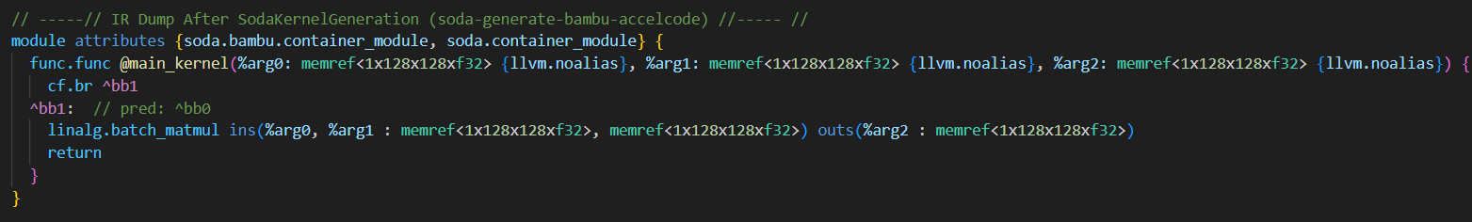
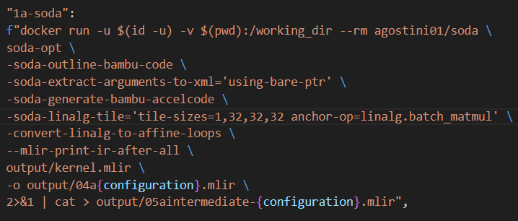
SODA Linalg Tile

Slide 67
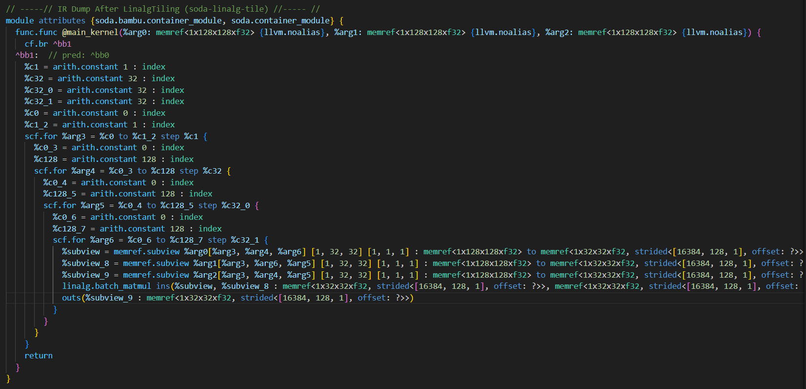
SODA Linalg Tile

Slide 68
SODA Linalg Tile
-soda-linalg-tile pass creates ASIC with the given tile sizes.
The main requirement for tiling dimensions is that the tiling dimension has to be a factor of the actual dimension.
Example: Let’s say a certain CNN layer has 88 output channels. Now this output channel can be tiled to one of its factors, e.g. 44. But it can’t be tiled to 32, as it is not a factor of 88.
For this, test-bench will have to be modified to remove the simulation time limit. If Verilator doesn’t finish simulation within its time limit.

Slide 69
Affine Loop Permutation - 2D Convolution
Output first permutation
Kernel first permutation

